Slide 1
Patti Sanchez
Chief Strategy Officer, Duarte, Inc., and author of Illuminate: Ignite Change Through Speeches, Stories, Ceremonies, and Symbols

Slide 2
Micro Biography (39 Words)
Patti Sanchez is Chief Strategy Officer at Duarte, Inc., where she creates communication strategies for the firm's clients. She is co-author of the award-winning book, Illuminate: Ignite Change Through Speeches, Stories, Ceremonies, and Symbols. Follow her on Twitter: @pattisan
Short Biography (62 Words)
Patti Sanchez is a communicator with over 25 years of experience leading transformative marketing initiatives for brands and causes, and co-author of the award-winning book, Illuminate: Ignite Change Through Speeches, Stories, Ceremonies, and Symbols. As Chief Strategy Officer for Duarte, Inc., Patti creates communications IP and counsels clients to create authentic connections with their audiences through persuasive presentations. Follow her on Twitter: @pattisan.

Slide 3
Medium Biography (154 Words)
Patti Sanchez is a communicator with over 25 years of experience leading transformative marketing initiatives for brands and causes, and co-author of the award-winning book, Illuminate: Ignite Change Through Speeches, Stories, Ceremonies, and Symbols. As the Chief Strategy Officer for Duarte, Inc., Patti leads an expert team of writers and consultants who help clients create compelling presentations that change beliefs and behavior.
Applying insights from her study of psychology and persuasion, Patti helps leaders understand the inner workings of the human mind and heart and then use that knowledge to craft engaging narratives that cut through the clutter and resonate on a deep level. She has presented hundreds of workshops on communication to marketing and sales leaders around the country and her professional work has been honored by IABC, BMA, and Vital Speeches of the Day. Patti holds a Bachelor of Arts Degree in Public Relations from San Jose State University with a minor in Psychology.

Slide 4
Long Biography (369 Words)
Patti Sanchez is a communicator with over 25 years of experience leading transformative marketing initiatives for global brands including Adobe, Cisco, Ericsson, HP, Jive, LexisNexis, McKesson, Nike, Panasonic, Symantec, VMware, Yahoo!, and GE. As the Chief Strategy Officer for Duarte, Inc., Patti leads a team of expert writers and consultants, provides strategic counsel to clients to help them create compelling presentations that change beliefs and behavior, and defines new services and IP for the agency. She co-authored the award-winning book Illuminate: Ignite Change Through Speeches, Stories, Ceremonies, and Symbols with Nancy Duarte. Illuminate shows how the world’s greatest leaders use powerful communication to move people and ideas forward.
Patti is a gifted writer, but her true passion lies in helping other communicators create authentic, empathetic connections with their audiences. Applying insights from her study of psychology and persuasion, Patti helps leaders understand the inner workings of the human mind and heart and then use that knowledge to craft engaging narratives that cut through the clutter and resonate on a deep level. Patti’s public speaking career began in high school, when she delivered the valedictory address for her graduating class. Since then, Patti has presented hundreds of workshops on communication to marketing and sales leaders around the country and her professional work has been honored by IABC, BMA, and Vital Speeches of the Day.
In addition to her professional pursuits, Patti has used her training as a communicator to benefit several community services organizations. She has used her skills to support a variety of causes, including serving on the board of a foster care organization called Future Families, consulting for the tolerance education pioneer Facing History and Ourselves, and teaching apprenticeships for inner-city kids at Citizen Schools. Patti holds a Bachelor of Arts Degree in Public Relations from San Jose State University with a minor in Psychology. Back in college, she won a national scholarship from the American Public Transit Association for her rousing essay on the benefits of riding the bus—an adventure she happily traded for the driver’s seat in a zippy Mini Cooper.
Patti is married to her high-school sweetheart, James, and together they enjoy eating great food, listening to live music, and taking road trips with their dog.

Slide 5
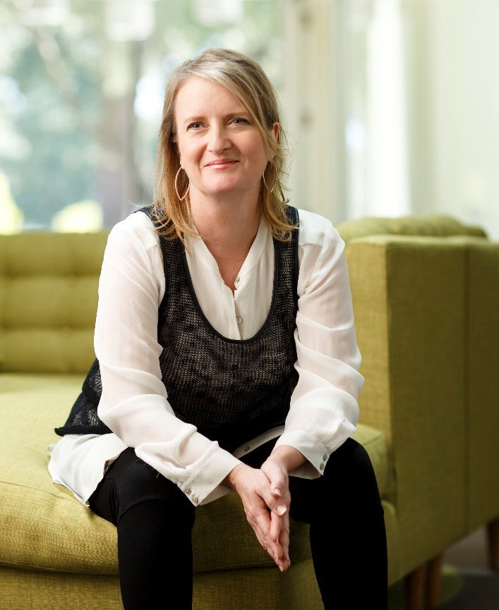
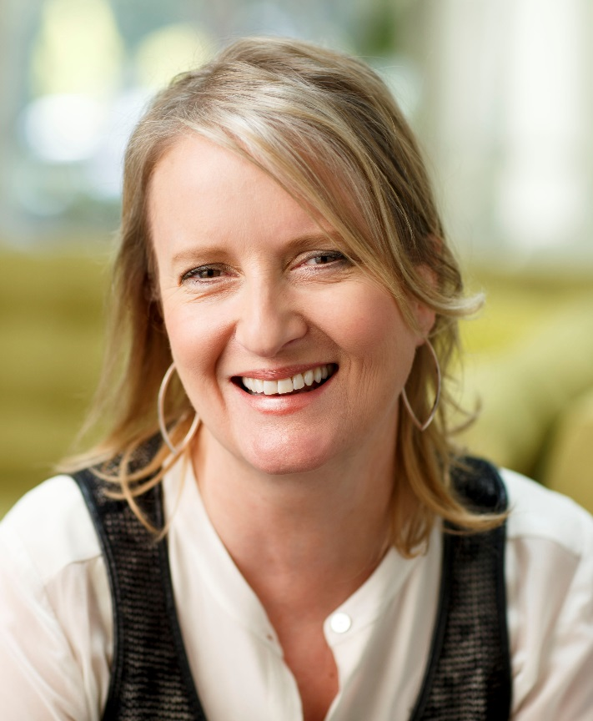

Slide 6
